Slide 1
An Utility Bill and Government Toll Payment System using Blockchain Technology
Supervised by
Professor Dr. M.M.A. Hashem
Department of Computer Science and Engineering
Khulna University of Engineering & Technology
Presented by
Name: | Sajidul Islam
Roll: | 1707010
Name: | Samiul Baree Sifat
Roll: | 1707035
Presentation Date: 13/02/2023

Slide 2
Outline
Introduction
Flaws in Traditional System
Objectives
Blockchain
System Architecture
Limitations and Future Works
Conclusions
Ethereum
Smart Contract
Environmental Setup
References

Slide 3
Introduction
Government service tax such as road toll, entry fee in any government powered establishment etc. is sometimes have been worrying part of the taxation.
There is possibilities of corruption such as tax fraud, more then allocated tax etc.
The Government of Bangladesh has a number of agencies that provide the citizens of the nation with various utility services, including power, gas, water, and the internet
One approach could be to make the system decentralize so that these problems does not happen.

Slide 4
Flaws in Traditional System
Extortion
Time Consuming
Need More Manual Labor
Toll fraud
Costly

Slide 5
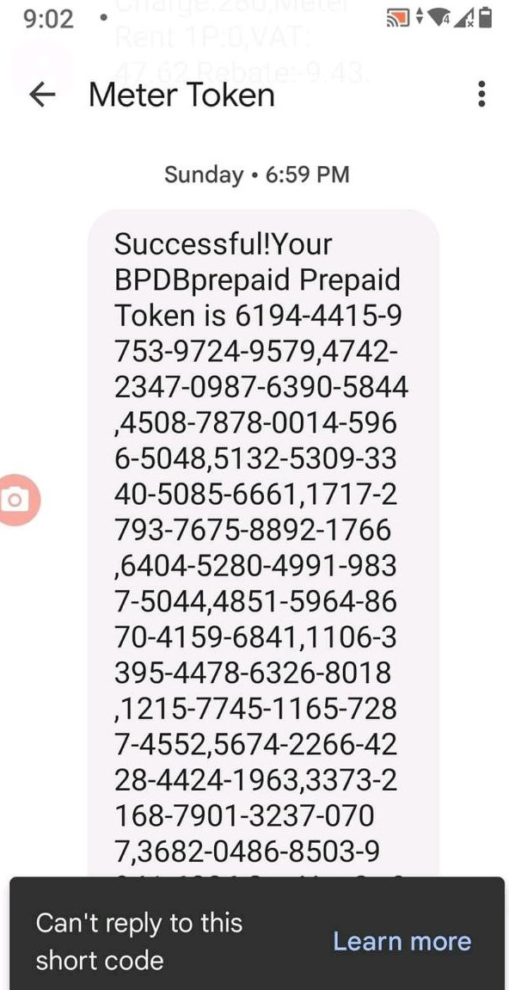
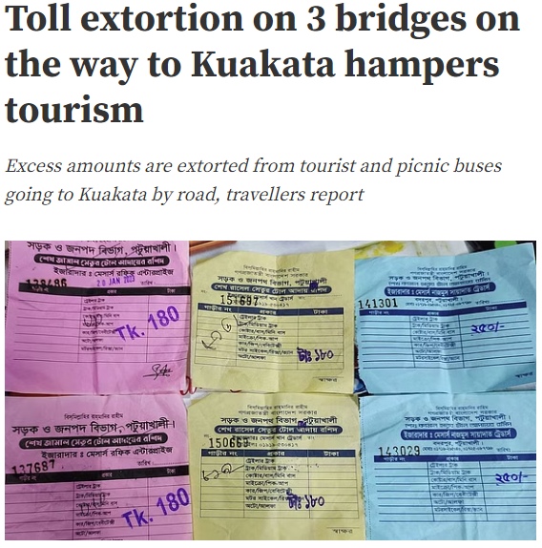
Flaws in Traditional System (Contd.)
Figure–1: 200 digit token of PDB
Figure–2: BDnews24 report on Extortion

Slide 6
Objectives
Our objectives is to try to prevent the corruption that’s happening by:
Increase security by using Blockchain.
Make the process faster and cheaper than before.
Transparency.
Immutability.

Slide 7
Blockchain

Slide 8
Blockchain
A Blockchain is a type of Digital Ledger Technology that consists of growing list of Records, called Blocks, that are securely linked together using cryptography.
- Wikipedia

Slide 9
Block Representation
1. Data: “Hello World!”
2. Prev. Hash: 1894A19C85
3. Own Hash: 43FC004C891
Figure–3: Block representation of a blockchain

Slide 10

Visual Representation of blockchain
Genesis Block
1
2
3
4
1. Data: XXXXXX
1. Data: AAAAAAAA
1. Data: BBBBBBB
2. Prev. Hash: 000000000
2. Prev. Hash: 1894A19C85
2. Prev. Hash: 43FC004C8
3. Own Hash: 43FC004C8
3. Own Hash: 1894A19C85
3. Own Hash: D4AF6C43FD
Figure–4: Visual Representation of Blockchain

Slide 11


Immutability of Blockchain
1
2
3
4
ZZZZZZZ
1. Data: XXXXXX
1. Data: BBBBBBBBB
1. Data: BBBBBBB
2. Prev. Hash: 000000000
2. Prev. Hash: 43FC004C8
2. Prev. Hash: 1894A19C85
3. Own Hash: 43FC004C8
3. Own Hash: 1894A19C85
3. Own Hash: D4AF6C43FD
1604B26F8C
Figure–5: Visual Representation of Blockchain
“BLOCKS ARE CRYPTOGRAPHICALLY LINKED TOGETHER”

Slide 12
Ethereum

Slide 13

Ethereum
Ethereum is a decentralized, open-source blockchain with smart contract functionality. Ether is the native cryptocurrency of the platform. Among cryptocurrencies, Ether is second only to Bitcoin in market capitalization.

Slide 14
Why Ethereum
Supports decentralized Applications.
Smart contracts.
Communicate with the chain Using Solidity.
Cognitive Currency, Ether (ETH).

Slide 15
Smart Contracts

Slide 16
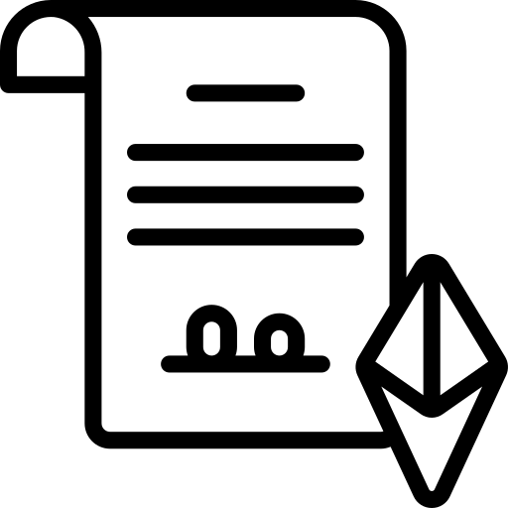
Smart Contracts
Figure–6: Smart Contract in a Blockchain
A smart contract is an agreement, in the form of a computer program that is executed automatically once certain pre-programmed conditions are satisfied.

Slide 17
System Architecture

Slide 18



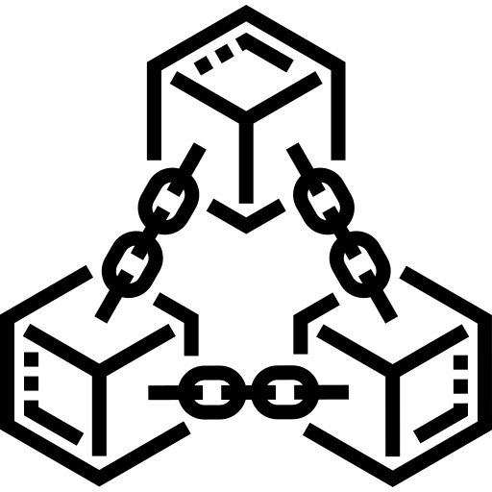

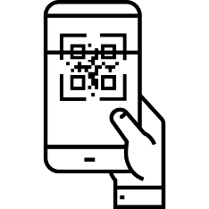

User Side
Government Side
users
Login
Authorize
Information
User Input
(Address)
Payment
Login via MetaMask
Unauthorize
Information
Smart Contract in
BlockChain
Retrieve
Information
Scan
QR code
Validate by
Blockchain
18
Figure-7: System Architecture

Slide 19
Environmental Setup

Slide 20
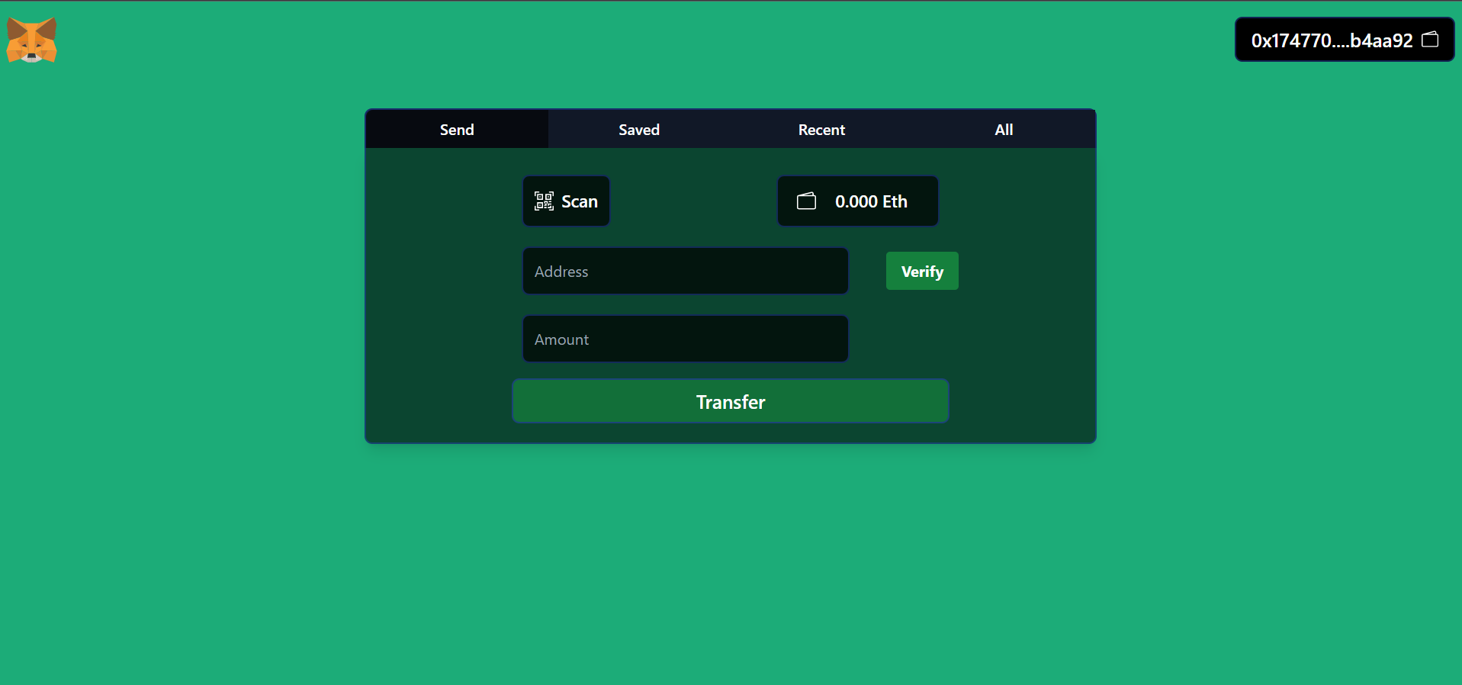
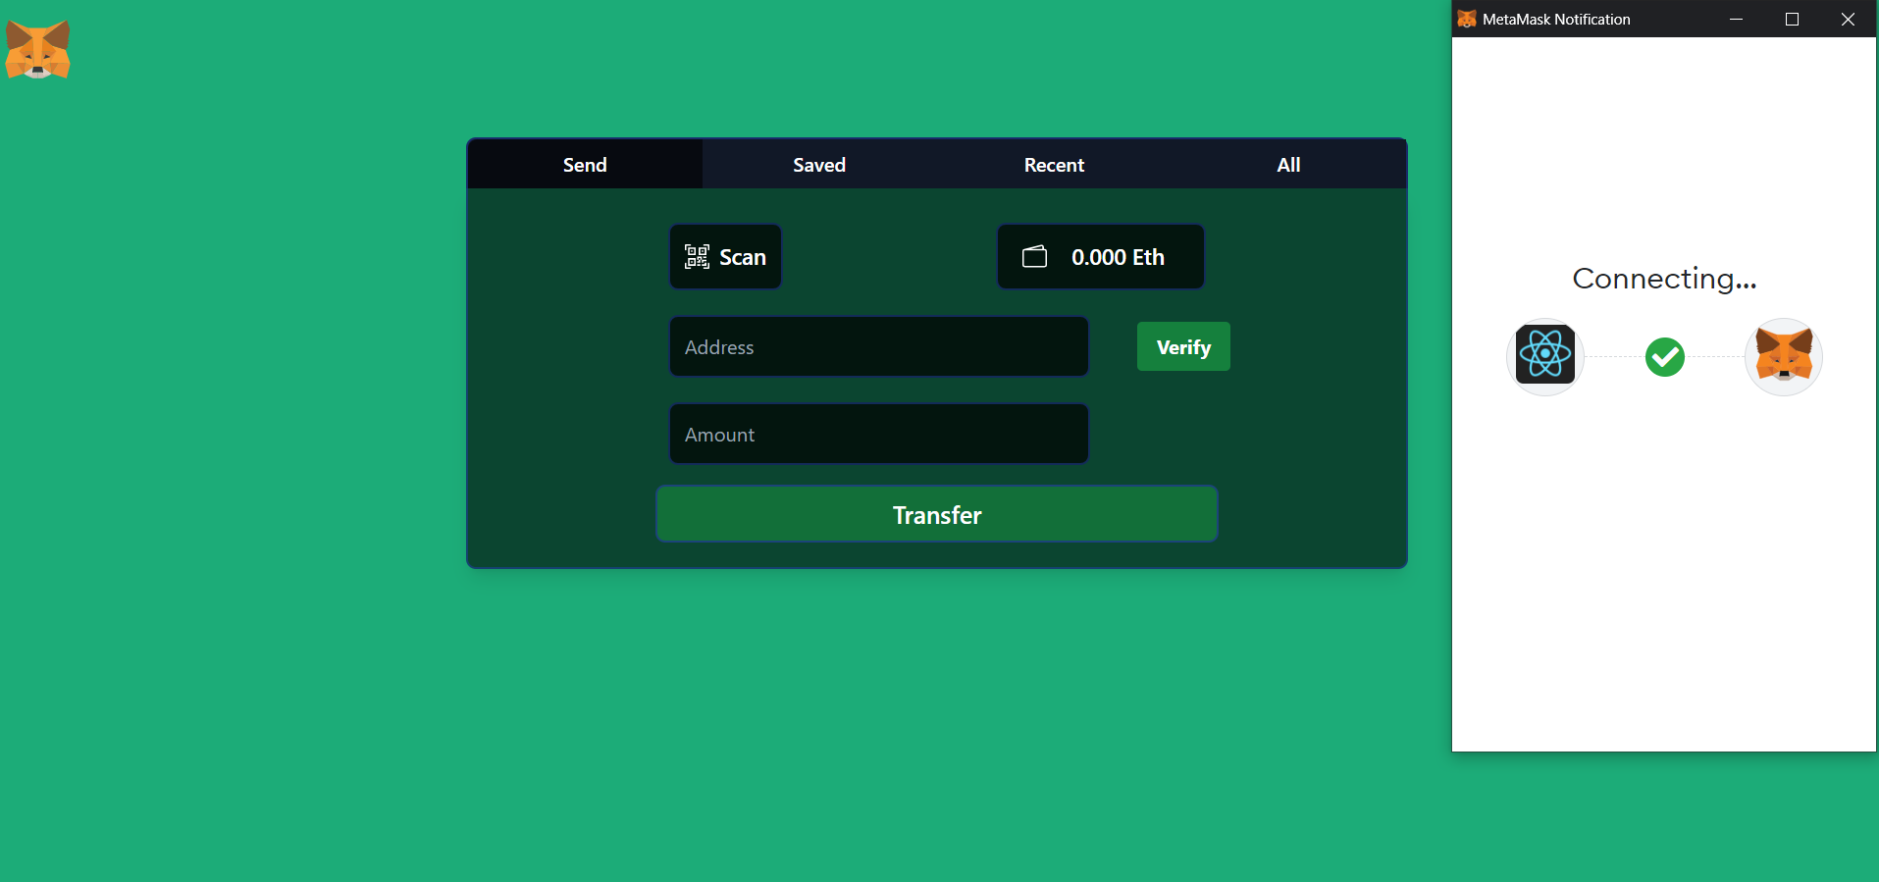

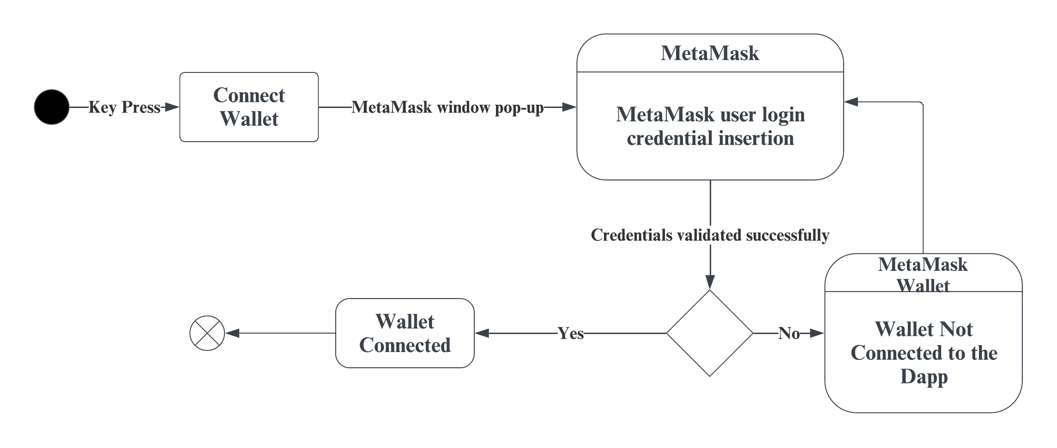
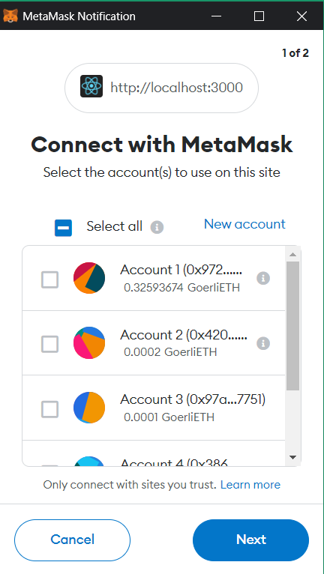
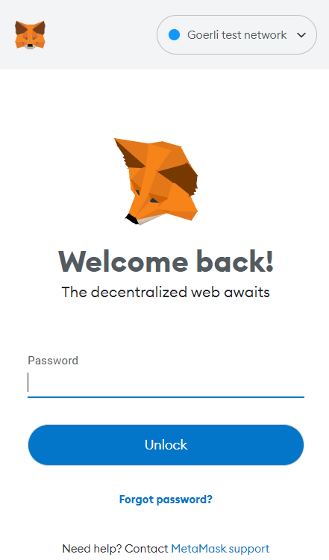
Environmental Setup
Login:
Figure–8: Login using MetaMask

Slide 21
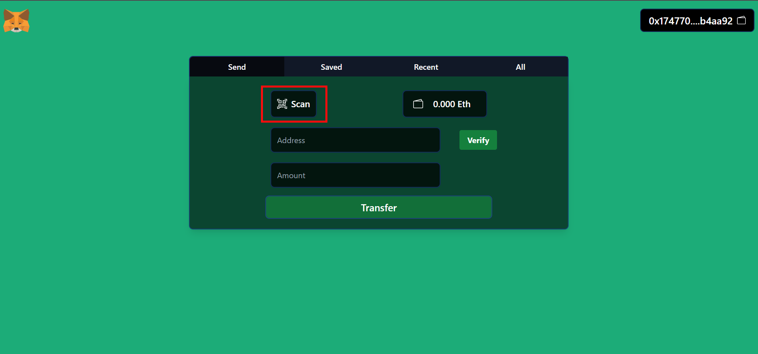
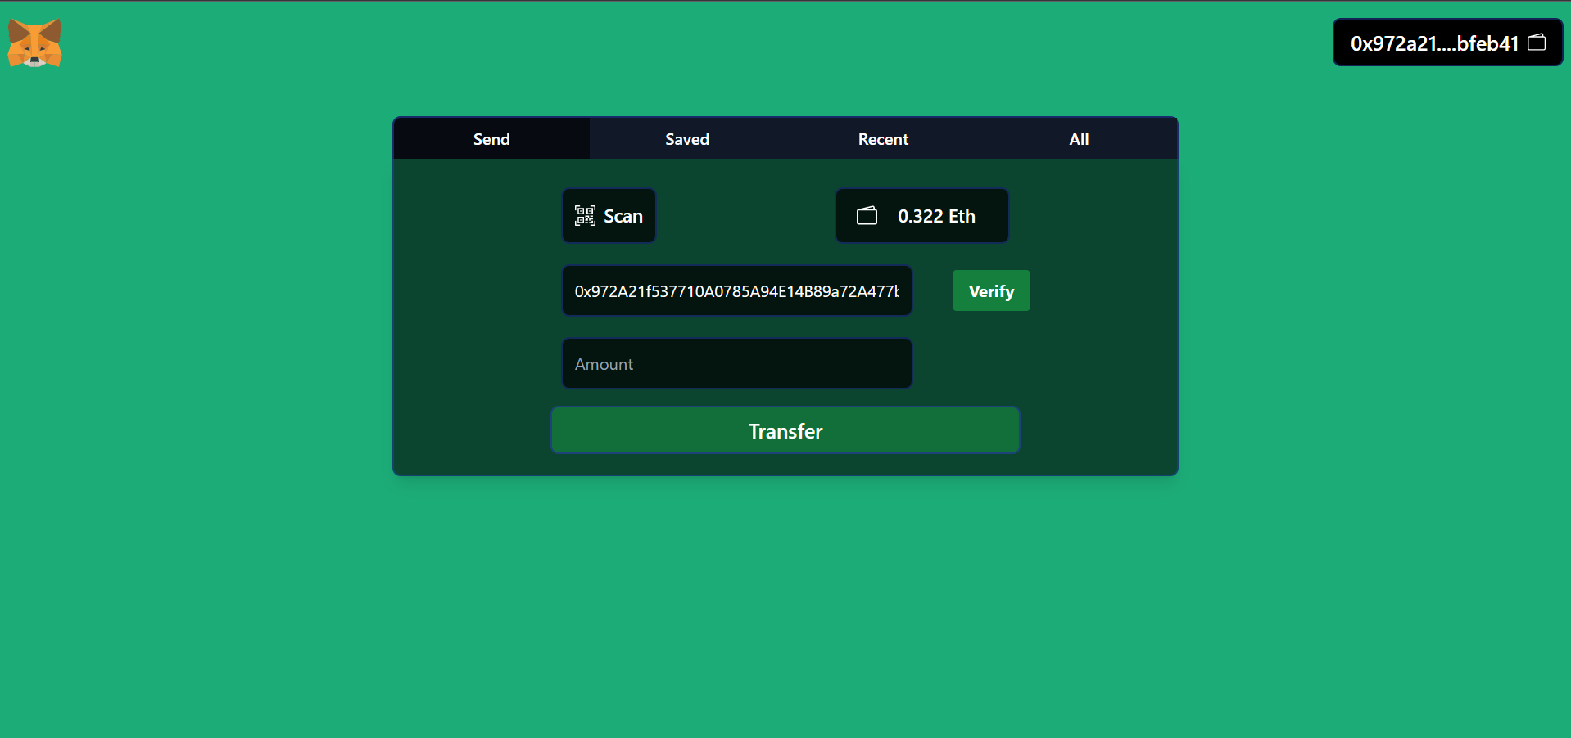
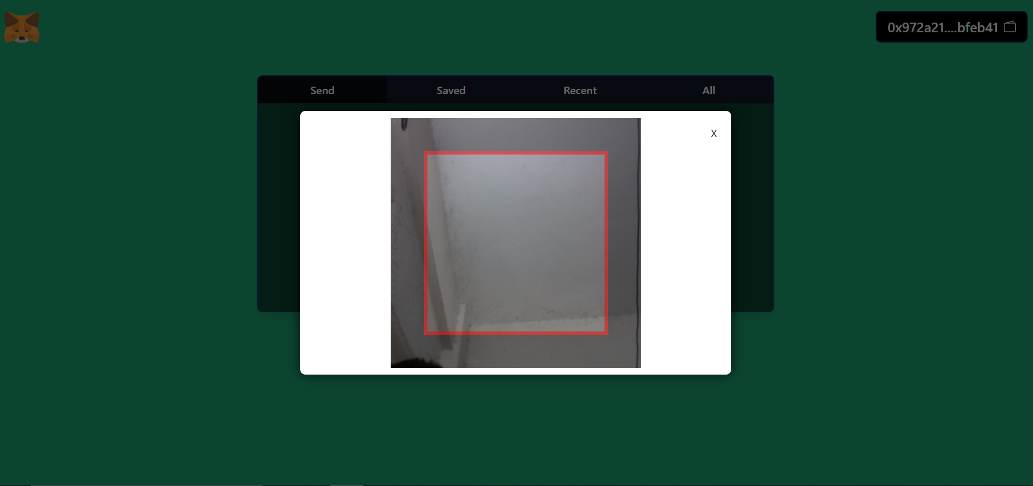
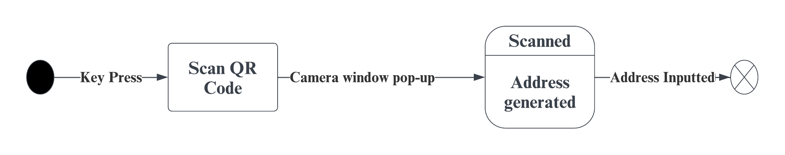
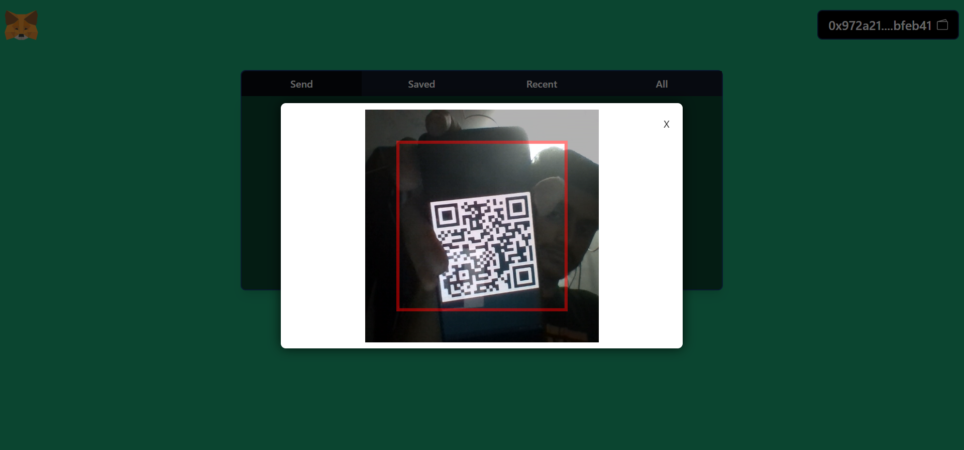
Environmental Setup
QR Scan:
Figure–9: QR Code Scanning

Slide 22
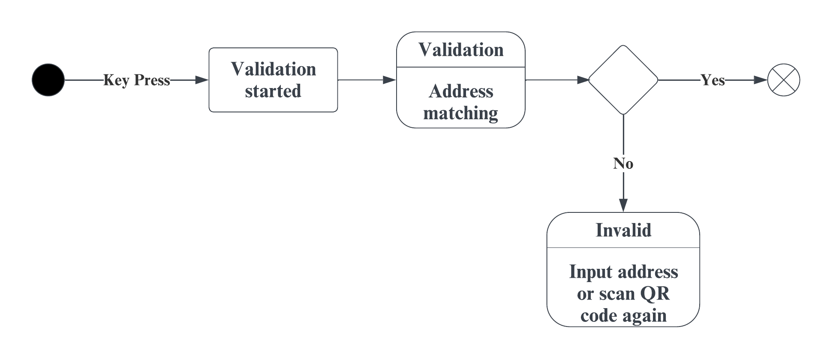
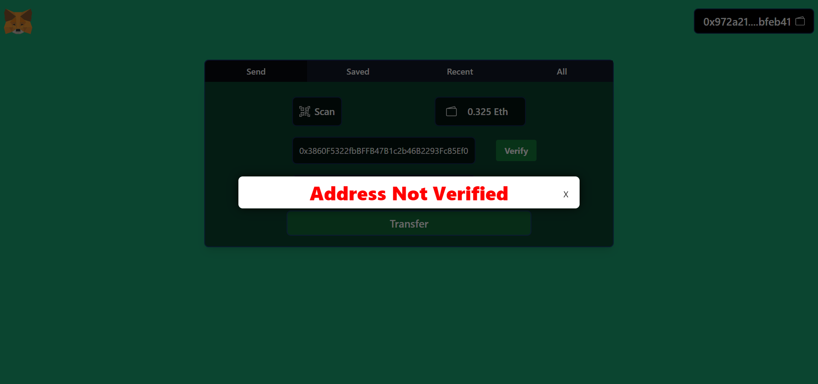
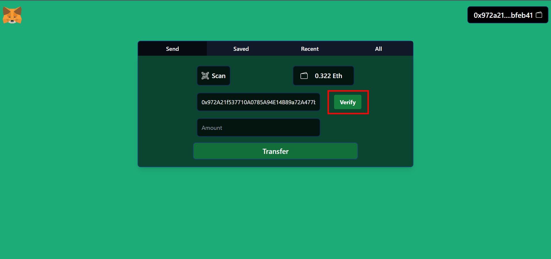
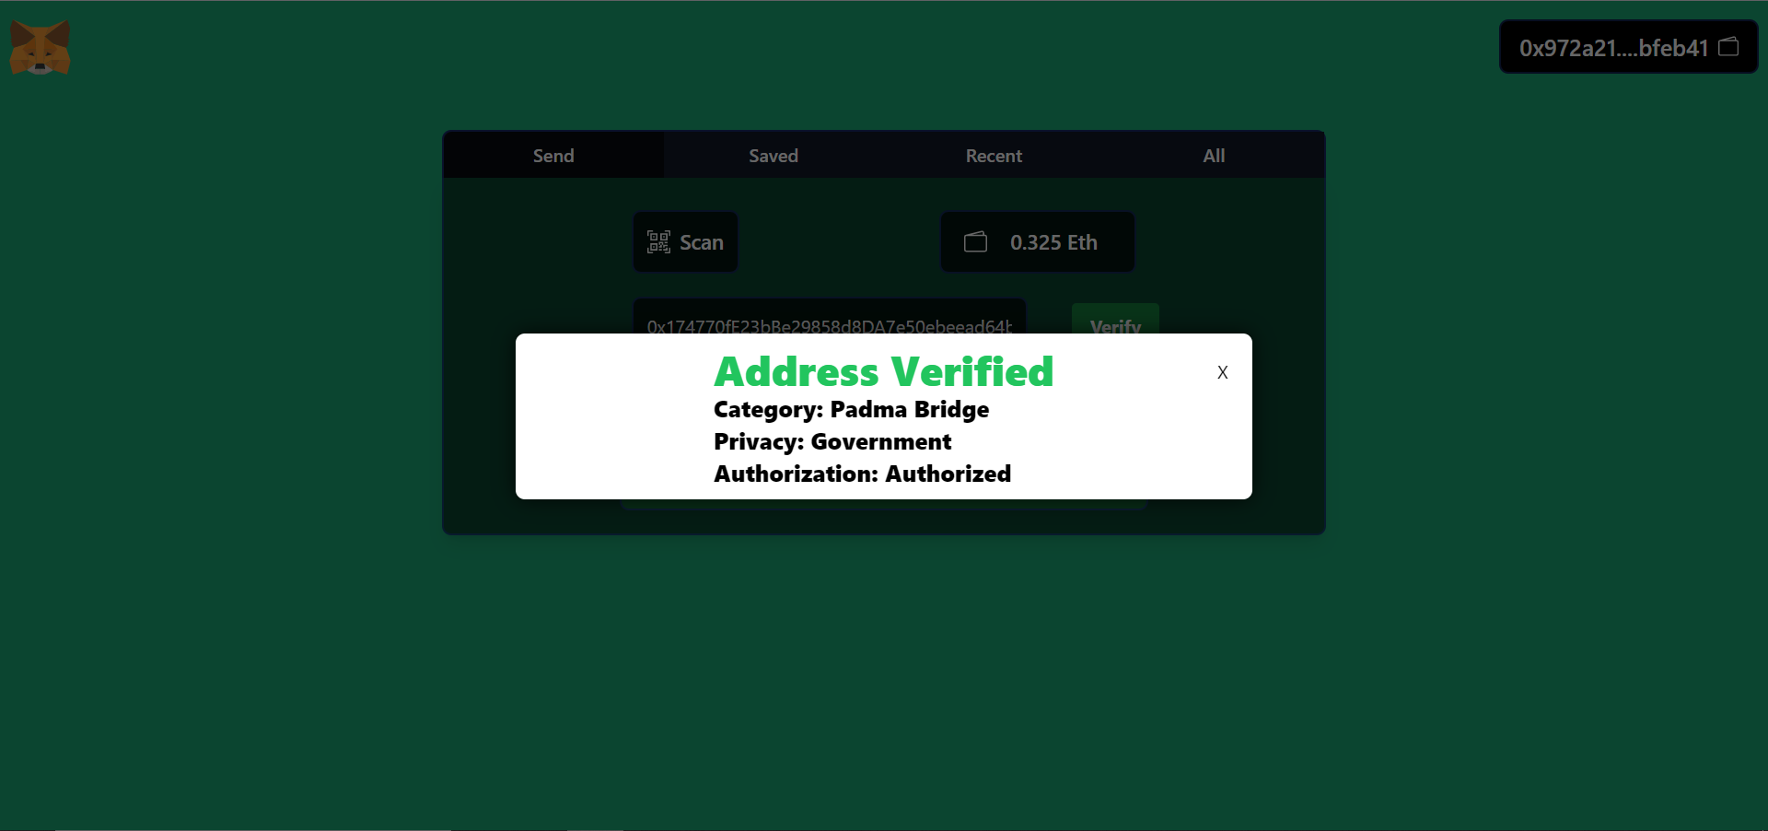
Environmental Setup
Address Validation:
Figure–10: Address Validation

Slide 23
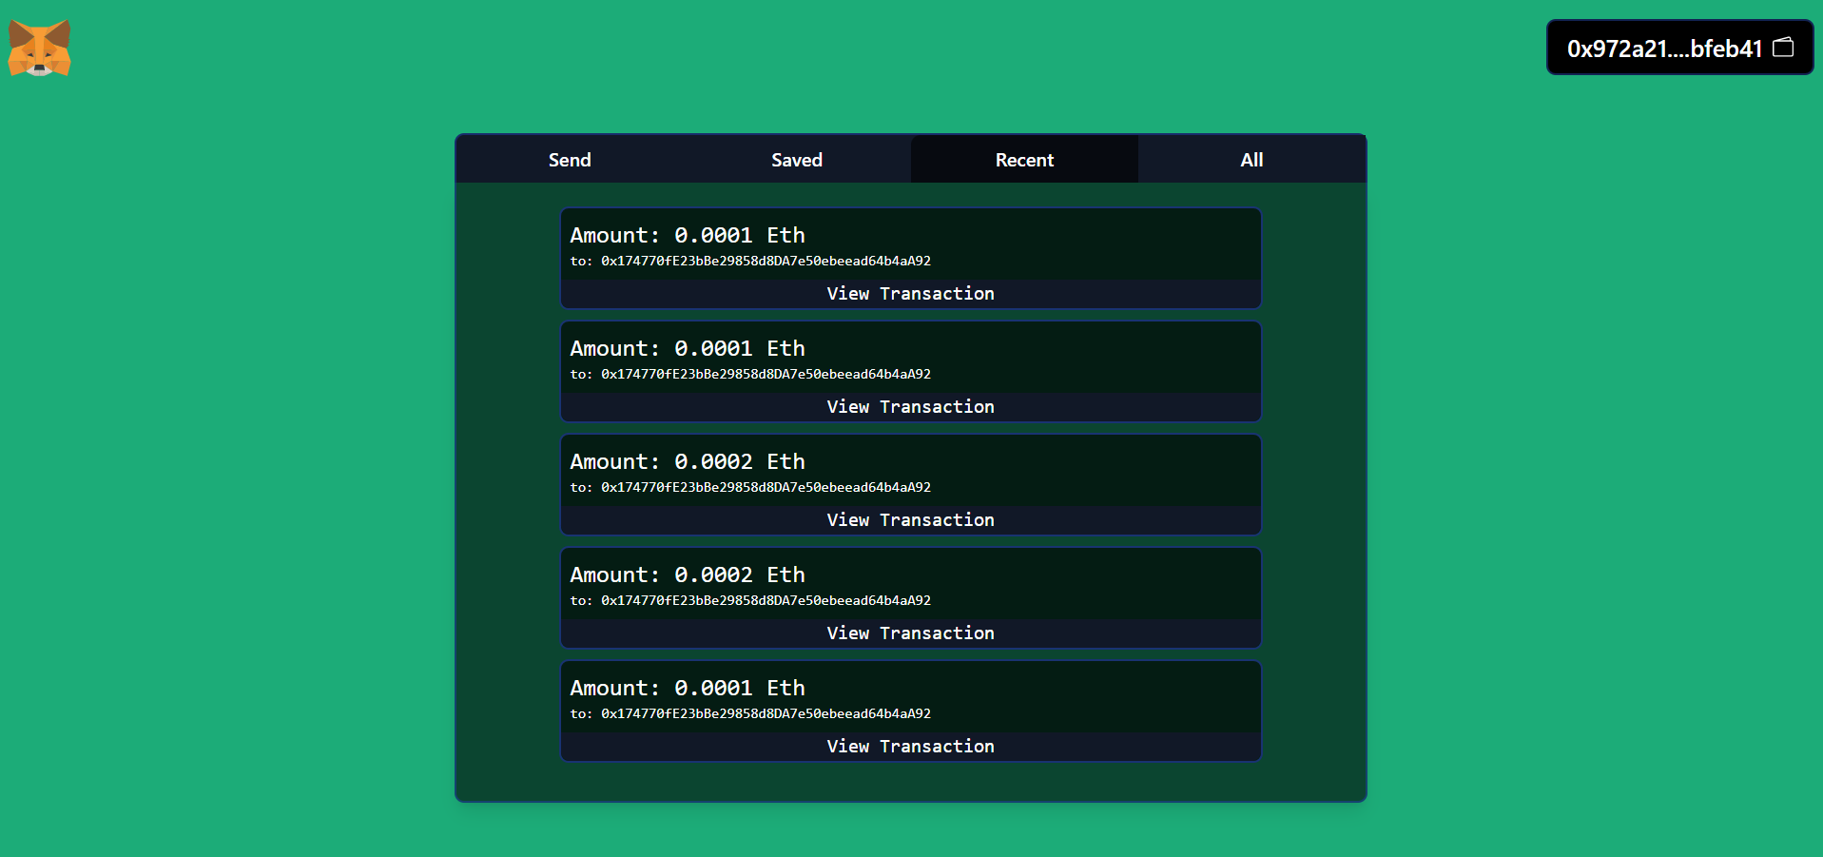
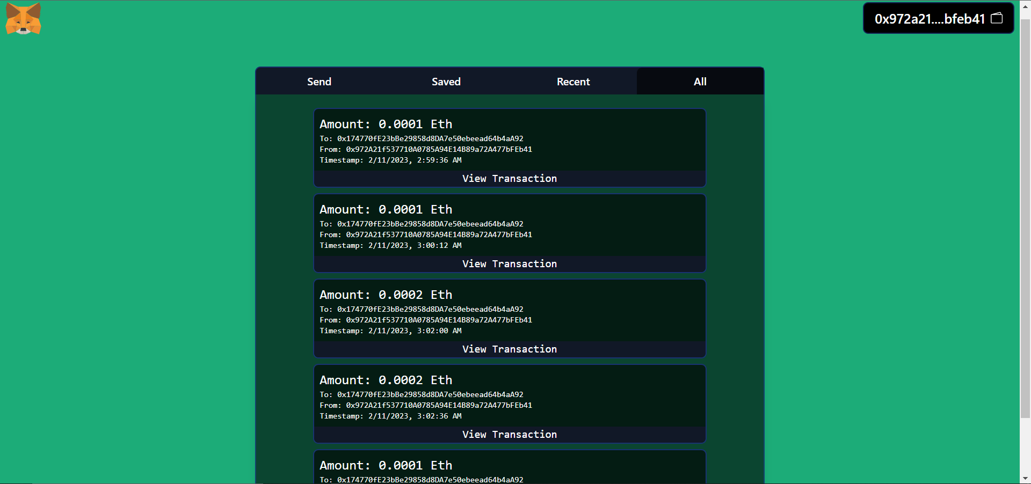
Environmental Setup
Recent Transactions:
All Transactions:

Slide 24
Limitations and Future Works
Limitations
The system needs internet connection spontaneously.
The regulatory environment for decentralized applications is still evolving, and it can be difficult for our system to operate in a legal and compliant manner.
Our User Interface is not so enriched with features and has some small but fixable bugs.
If the payment information is incorrect it can no longer be easily changed.

Slide 25
Limitations and Future Works
Future Works
We can use off-chain smart contracts to further reduce cost and increase computation.
We can use RFID with blockchain to make this payment process much easier, where we can use NFC to connect two people and then make payments between them using a smart contract.
Adding automated payment reminders can help customers stay on top of their bills and avoid late payments and associated penalties.

Slide 26
Conclusions
It brings transparency to the system.
It makes system autonomous.
Helps making transaction faster and more secure.
Reduces Cost.
More secure then traditional approach.

Slide 27
References
Daniel Zinca and Vlad-Andrei Negrean. Development of a road tax payment application using the ethereum platform. In 2018 International Symposium on Electronics and Telecommunica- tions (ISETC), pages 1–4. IEEE, 2018.
Satoshi Nakamoto. Bitcoin: A peer-to-peer electronic cash system. Decentralized Business Review, page 21260, 2008.
Vitalik Buterin et al. A next-generation smart contract and decentralized application platform white paper, 3(37):2–1, 2014.
What is Ethereum? By Alex Moskov < https://coincentral.com/>

Slide 28
References
H. Hyvarinen, M. Risius, and G. Friis, “A blockchain-based approach towards over-coming financial fraud in public sector services,” Business & Information Systems Engineering, vol. 59, pp. 441–456, 2017.
K. Wu, “An empirical study of blockchain-based decentralized applications,” arXiv preprint arXiv:1902.04969, 2019.

Slide 29
Thank You
Any Questions?
29

